Slide 1
Product
The product life cycle

Slide 2
Surf Inc discussion question
Choosing between a mass market and niche market strategy depends on various factors, including the nature of the product, target audience, competition, and resources available.
Mass Market Strategy:
Pros:
Wide Reach: Targeting the mass market allows Surf Inc. to reach a larger audience, potentially increasing sales volume.
Economies of Scale: With a larger customer base, Surf Inc. may benefit from economies of scale in production, distribution, and marketing, leading to lower costs per unit.
Brand Recognition: Mass marketing can help build brand awareness more quickly, especially if Surf Inc. plans to expand rapidly.

Slide 3
Cons:
High Competition: Targeting the mass market means competing with established brands and companies with larger budgets for marketing and advertising.
Generic Positioning: Surf Inc. might struggle to differentiate itself in a crowded market, potentially leading to price wars and reduced profit margins.
Intensive Capital Requirement: As a small business, Surf Inc. may have limited funds and therefore be unable to obtain the same economies of scale as larger organisations

Slide 4
Niche Market Strategy:
Pros:
Focused Audience: Targeting a niche market allows Surf Inc. to tailor its products and marketing efforts to a specific group of consumers with unique needs and preferences.
Higher Profit Margins: Niche markets often have less competition, allowing Surf Inc. to charge premium prices for its unique surf clothes.
Brand Loyalty: Building a strong presence within a niche can lead to high levels of brand loyalty and repeat business from passionate customers.
Less Competition: By focusing on a specific segment, Surf Inc. can avoid direct competition with larger brands and differentiate itself based on quality, design, or even sustainability.

Slide 5
Cons:
Limited Reach: Targeting a niche market means limiting the potential customer base, which could restrict sales growth and expansion opportunities.
Vulnerability to Market Changes: Niche markets may be more susceptible to economic downturns or shifts in consumer preferences, potentially impacting Surf Inc.'s sales.
Higher Costs: Serving a niche market may require higher marketing and production costs per customer, as Surf Inc. needs to invest in specialized advertising and smaller-scale manufacturing.

Slide 6
Recommendation:
Considering Surf Inc. is a startup with unique surf clothes, initially, a niche market strategy might be more advantageous. By focusing on a specific segment of surf enthusiasts who value creativity, quality, and uniqueness, Surf Inc. can establish itself as a premium brand and build a loyal customer base. Once the brand gains recognition and solidifies its position within the niche market, it can gradually expand its reach to broader customer segments through a mass market strategy.

Slide 7
Benefits and features
Benefit:
How something gives value to your life. A bicycle allows transportation and a mobile allows communication to others
Feature:
The physical characteristics of a product such as the weight, colour, design and packaging

Slide 8
Packaging benefits
Packaging adds value in many ways

Slide 9
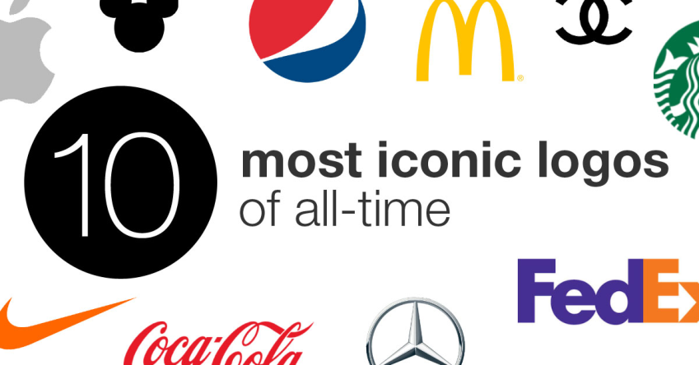


Branding
A unique, consistent and easily recognisable character or picture.
The purpose of branding in marketing is to establish trust within your consumers and create loyalty.
Your brand not only gives your buyers a way to remember you, but it also creates an identity for your business and sets you apart from competitors

Slide 10
Life cycle stages
Just like the life cycle of a human, a product undergoes similar stages.
Development, Introduction, Growth, Maturity and Decline
Businesses are required to do different things during each stage of the life cycle.

Slide 11
Product life cycle
How long a product is in the market for before it disappears
Depends of factors such as competition, type of product, marketing support and customer tastes

Slide 12
Examples
Products with quick life cycles are… toys, fashion, certain electronic products
Products with long life cycles are… Coca cola, Kellogs cereal, certain technologies (constant modification)

Slide 13
Development Stage
High costs (Design, promotion and manufacturing eg. Labour)
No sales causing cash flow problems.
How do businesses deal with this? *not in book

Slide 14
Introduction stage
Newly released on the market, requires heavy promotion and advertising to create product awareness.
Product may still lose money due to low amount of sales.

Slide 15
Growth Stage
Sales rise, profit may be made if enough revenue is made to cover the costs.
New competitors may enter the market at this stage

Slide 16
Maturity Stage
Eventually sales will stabilise and remain constant.
Promotions will still be needed to keep brand awareness high eg. Nike Air Jordans, Coca Cola, Apple Iphones

Slide 17
Decline Stage
Sales begin to decrease
If the product is not withdrawn, then a company may use extension strategies to revitalise the product as seen in the book (Giving new life)

Slide 18
Giving new life
To prolong the life cycle, new life needs to be injected to the marketing mix. There are various ways of doing this.
Modifying the product –
Altering distribution patterns -
Changing prices -
Promotional campaigns -

Slide 19
Marketing assignment
Refer to qiba.space “marketing mix activity” for full details
Due date is 19th of May
Our ability for collaboration is what separates us from every other species on this planet
Learn to work with your team members, especially important for creating good marketing mix and strategy.

Slide 20
Homework
Summary question 1+3, take some notes in your textbook.
Short answer question 14 on page 104 to my email.
Look at the marketing assignment and rubric

