Slide 1
7.3 Graphs
7.4 Market segmentation

Slide 2
Why use each graph?
Pie chart/graph shows:
Positive –
Negative –
Bar chart shows:
Positive –
Negative –
Line graph shows:
Positive –
Negative –
Complete summary question 1.

Slide 3
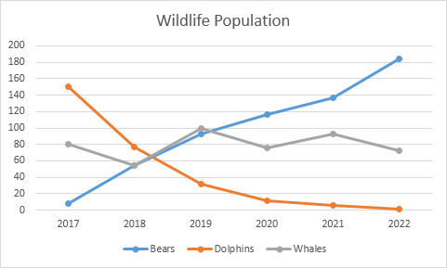
Graphs
Understand the benefit of each type of graph in English
Line graphs
  Show size and speed (comparable)
  Will see more often throughout your studies
Scale
Y-Axis
X-Axis
Legend/Key
Title

Slide 4
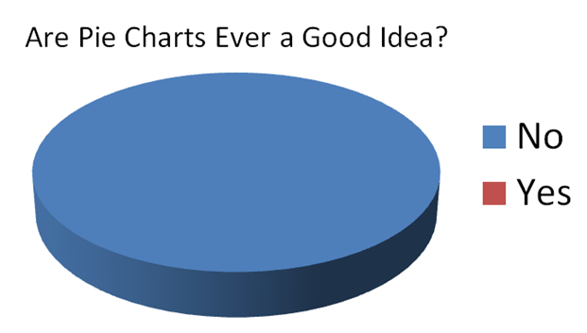
The whole market/ Target Market

Slide 5
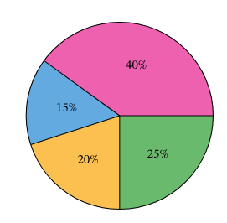
This pie chart is …

Slide 6
Market segmentation
What is market segmentation? Similarly, what does it mean when the market is segmented?

Slide 7
Question and activity
Is it possible to satisfy all your customers with a product?

Slide 8
Definition
A market segment is a potential group of customers who share similar characteristics.
Marketing professionals approach each segment differently, but only after fully understanding the needs, lifestyles and personality of the target consumer.

Slide 9
Market segments
What different segments of the market can you think of?
Why do marketers choose to segment the market?

Slide 10
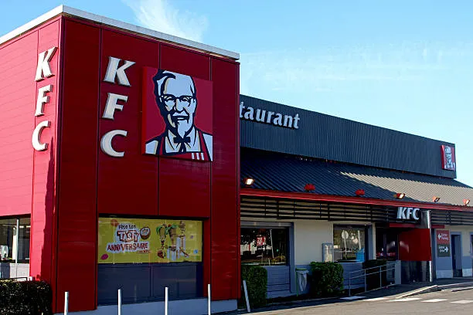
Location segmentation
By region or country as they often have common characteristics which influence buying attitudes e.g. income per person or tastes and preferences

Slide 11

Age and Gender
Different age groups have vastly different wants and needs, similarly, different genders have different needs.
Use activity on page 86 to get some examples

Slide 12

Income and social Class
Income and class determine the likelihood of spending e.g. high income can buy branded perfumes while low income buy cheaper perfumes.

Slide 13
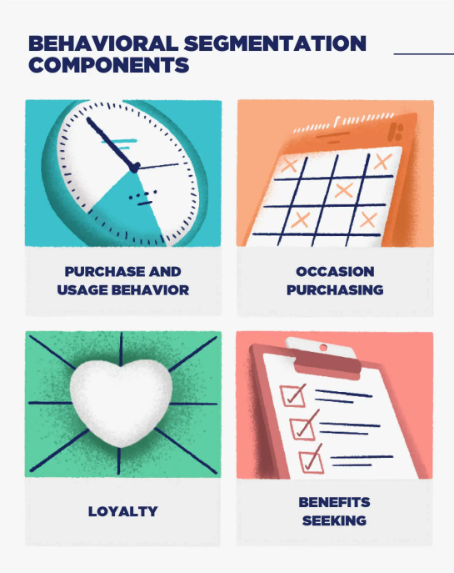
Behavioural segmentation
The process of sorting and grouping customers based on their behaviours.
Exercise everyday

Slide 14
Question
Which of the following is an example of behavioral segmentation?
a. a health club that targets college students
b. a resort that targets families with children
c. a florist that targets those who buy the most flowers
d. a restaurant that targets senior citizens

Slide 15
Other segments of the market
Can you think of any other potential segmentations?

Slide 16
McDonalds segmentation
Watch McDonalds segmentation video
How did McDonalds target their customers using market segmentation?

Slide 17
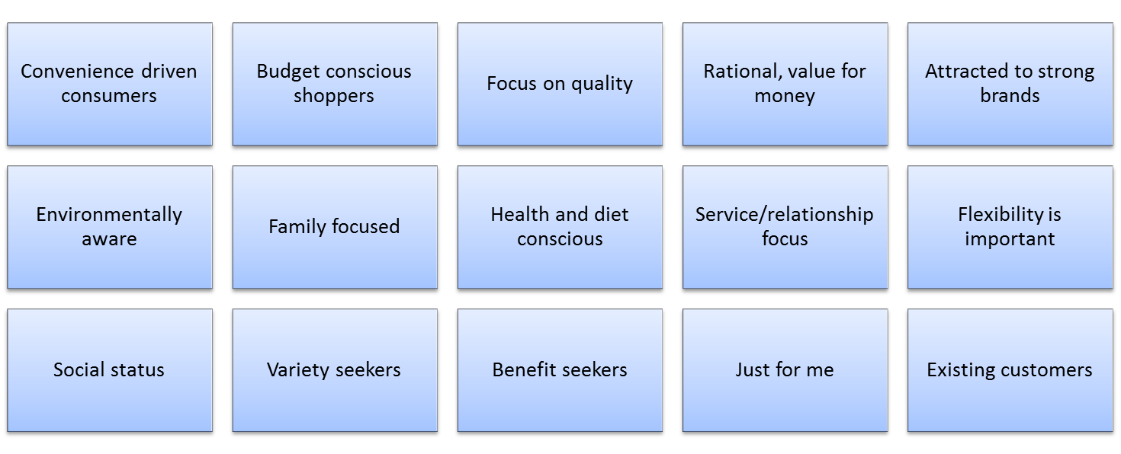
Other potential segments

Slide 18
How does this help business?
By understanding which segments show profit or growth, businesses will target those particular segments using a marketing mix (4 Ps) specifically designed to attract those customers.

Slide 19
Positive and negatives
Positives:
Market segmentation allows them to meet customer needs better which can result in higher brand loyalty, lower price sensitivity and overall more profits.
Negatives:
A greater range of products will often mean there are higher costs involved. This can be through Research and development, production costs or marketing costs.

Slide 20
Activity
Using the product you received for your market research activity, think of all the potential segments of the market you can target. How would your marketing campaign change for each segment and why?
How would you alter your product (4Ps) for each of these segments.

Slide 21
Homework
Summary questions 1
Short answer questions 8+9+10 no need to send to me, just know some examples.

