Slide 1
4.5 Competition and business
Unfair and uncompetitive markets

Slide 2
Direct and Indirect competition
Direct competition sells the same product eg. pineapples and pineapples
Indirect competition includes any other business within the market eg. pineapples and shoes

Slide 3
Types of uncompetitive/anti-competitive practice
Behaviour that reduces or limits competition in the market.
What are some things businesses may do to limit competition according to the textbook?

Slide 4
Types of uncompetitive markets
What kinds of markets are uncompetitive? Think of some examples

Slide 5
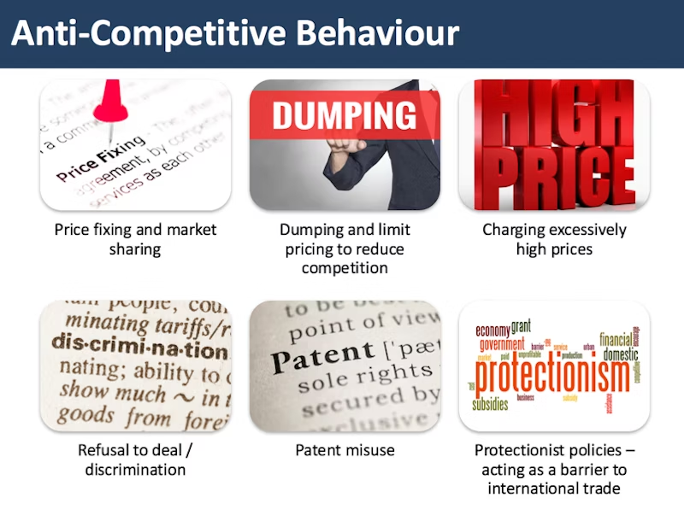
Other examples include:

Slide 6
Customer exploitation
  Consumer exploitation is a situation in which a consumer is cheated or given false information by the producer
  They are essentially being exploited by the business.
  Can you think of any other business actions that may exploit customers?

Slide 7
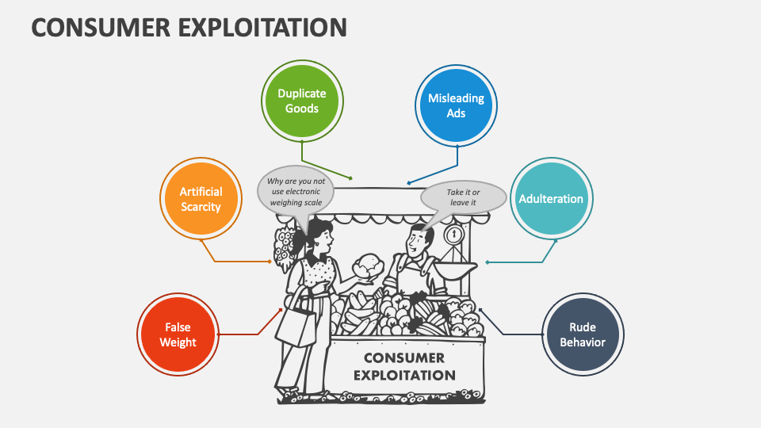

Slide 8
Definitions
Find the definitions in the book.
Price fixing:
Customer exploitation:
Collusion:
Who is responsible for the customers and businesses and what can they do?

Slide 9
Homework
Short answer questions 17-18 on page 46 to be sent to my EMAIL
Look at the new vocabulary from the unit
Revision next class

