Slide 1
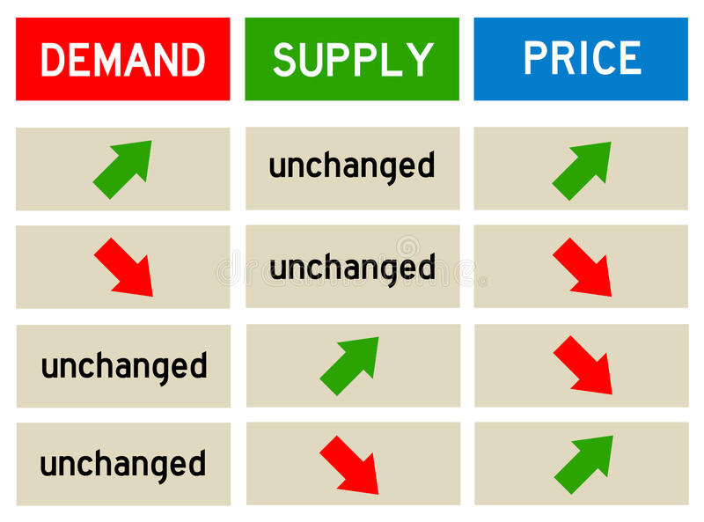
Supply and Demand

Slide 2
Subsidy
Reasons for providing subsidies
Essential private businesses such as farmers to keep supply high and price low
Private businesses that benefit the country e.g. high technology (green technology) / innovative businesses
Promote a sector of the market e.g. if there are no people selling a certain product, governments can provide a subsidy for people to start a business in that area.
Protect jobs – Motor industry e.g. Holden Australia

Slide 3
4.2 International trade
Benefits to the economy

Slide 4
What is it?
International trade is the exchange of goods and services across international borders/ to other countries. Domestic trade – trading within your borders

Slide 5
Group discussion
In groups, discuss with your partner how international trade amongst countries has benefitted you? As there any negatives to it?

Slide 6
Reading comprehension
Read 4.2 individually and answer the following questions
1. What are the benefits and risks of international trade
2. What is the definition of import and export
3. What are the benefits of importing and exporting. Are there any negatives?

Slide 7
Benefits
Specialisation – Focus on producing the things the country is very good at or has advantages in.
This surplus of production can then be traded for the goods of another country
Example: Nigeria produces cocoa and rubber which they then sell to other countries. They are not good at producing machinery and therefore use their trade surplus to buy these items.

Slide 8
Other benefits
Acquire scarce metals and minerals
Gain supply of goods they cannot produce enough of e.g. China and fresh food and vegetables
Give customers more choice e.g. car options
Earn foreign currency
More competition for domestic organisations
Increase relations between countries
Any negatives of international trade?
Risk

Slide 9
Import
What is it?
Purchasing products from overseas and transporting them to your home country
Benefits
Acquire the best supplies
More/less variety for customers and business
Cheaper/Expensive products
Better/worse quality
Any negatives?

Slide 10
Export
What is it?
Sale of products or services to individuals or businesses overseas.
Benefits
Helps domestic organisations grow and profit
Increase/decrease customer base
Increase/decrease brand awareness
Any negatives?

Slide 11
Comparative advantage VS Absolute advantage
Extra knowledge for the future
Go online and check what is comparative advantage and what is absolute advantage in regards to international trade!
What are the differences?
Can you use an example to describe them?
https://www.youtube.com/watch?v=Vvfzaq72wd0

Slide 12
Homework
Summary question 3, short answer question 5-6 on page 46 (By email)
Research and understand the difference between comparative advantage and absolute advantage.

