Slide 1
The workforce
Recruitment and selection

Slide 2
Recruitment
The process of attracting the right applicant to apply for a vacant position.
Can either be done internally or externally
What are some benefits of promoting compared to hiring from the outside? Discuss

Slide 3
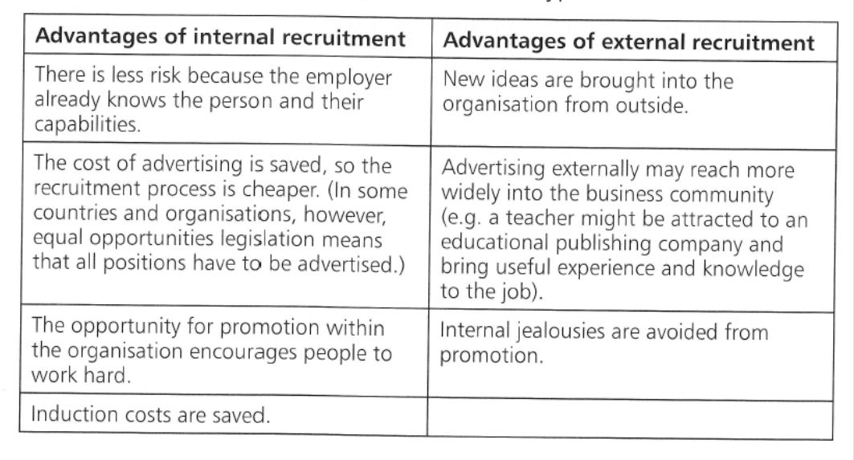
Which is better?

Slide 4
Selection
Choosing the most suitable applicant for the job/vacancy
Usually those that do well and meet the specifications of the organisation will be put on a shortlist
What do you think recruiters or employers are looking for in their employees? Discuss

Slide 5
Interview
Process of determining whether a candidate is suitable for a posixtion.
May contain many rounds of interviews depending on the job
Can be as a group and asked to do certain tests or activities.
What are some interview questions you might be asked? Discuss

Slide 6
Parts of a job advertisement

Slide 7
Activity
Pre-assignment activity
Step 1: Look online for two international job boards or websites that advertise job vacancies. Can be from any country, as long as it is in English.
Step 2: Share your website with the class
Step 3: Find 3 jobs you are interested in from the websites the class has provided
Step 4: Try to find the information of as many parts of a job advertisement (from the above slide).

Slide 8
Homework
Summary question 2+3
Short answer question 3-5 on page 168

