Slide 1
Headway Academic Skills, Reading, Writing, and Study Skills: Level 1, Student Book, page 56, task 1: Answers
the title page
the index
the printing history
the back cover
the contents page
Notes:
PPT Source: Teacher’s own materials

Slide 2
Whenever a person is doing research, he or she should always write down some publishing information about the sources of information that he or she uses.
Notes:
Photo source 1: Weimer, Maryellen. “The Questions We Should Be Asking Our Students”. Faculty Focus, 28th September, 2016, https://www.facultyfocus.com/articles/effective-teaching-strategies/questions-we-should-be-asking-students/. Retrieved 11th March, 2021.

Slide 3
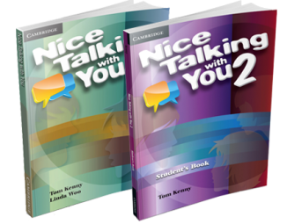
When a person uses a book as a source of information, what publishing information should he or she write down? Write at least 3 ideas in your notebook. Check you answers on the next slide.
Notes:
Photo source 2: Nice Talking With You, https://nicetalkingwithyou.com/. Retreived 11th March, 2021.

Slide 4
author's name
book's name
page number (which page did the information used come from?)
publisher's name (this may be a company)
publication date

Slide 5
Example 1:
Author’s name: Kevin Kwan
Name of the book: Rich People Problems
Page number: 36
Publisher's name: Tyersall Park, Ltd.
Date published: 2017
Notes:
Photo source 3: “Rich People Problems”. Audible, 1997-2021, https://www.audible.co.uk/pd/Rich-People-Problems-Audiobook/1473587638. Retrieved 11th March, 2021.

Slide 6
Where can a person find the name of the publisher or the publishing company? Write your answer in your notebook. Check your answer on the next slide.

Slide 7
on the printing history page (at the beginning of the book)

Slide 8
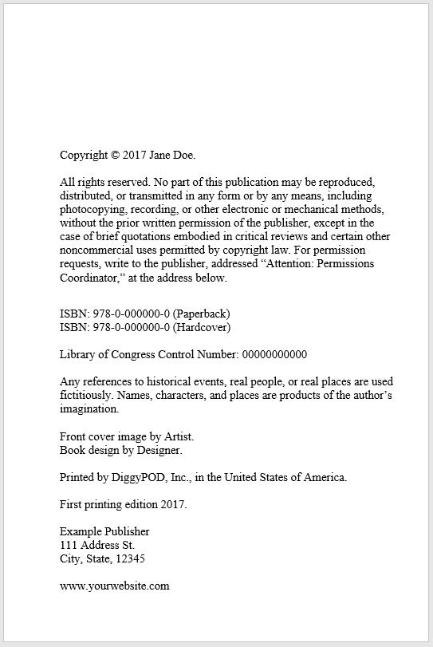
Who is the publisher of this book? Write your answer in your notebook. Check your answer on the next slide.
Notes:
Photo Source 4: ‘How to Create a Copyright Page’. DiggyPOD, 27th November, 2017, https://www.diggypod.com/self-publishing/copyright-page/. Accessed 25th February, 2020.

Slide 9
Jane Doe

Slide 10
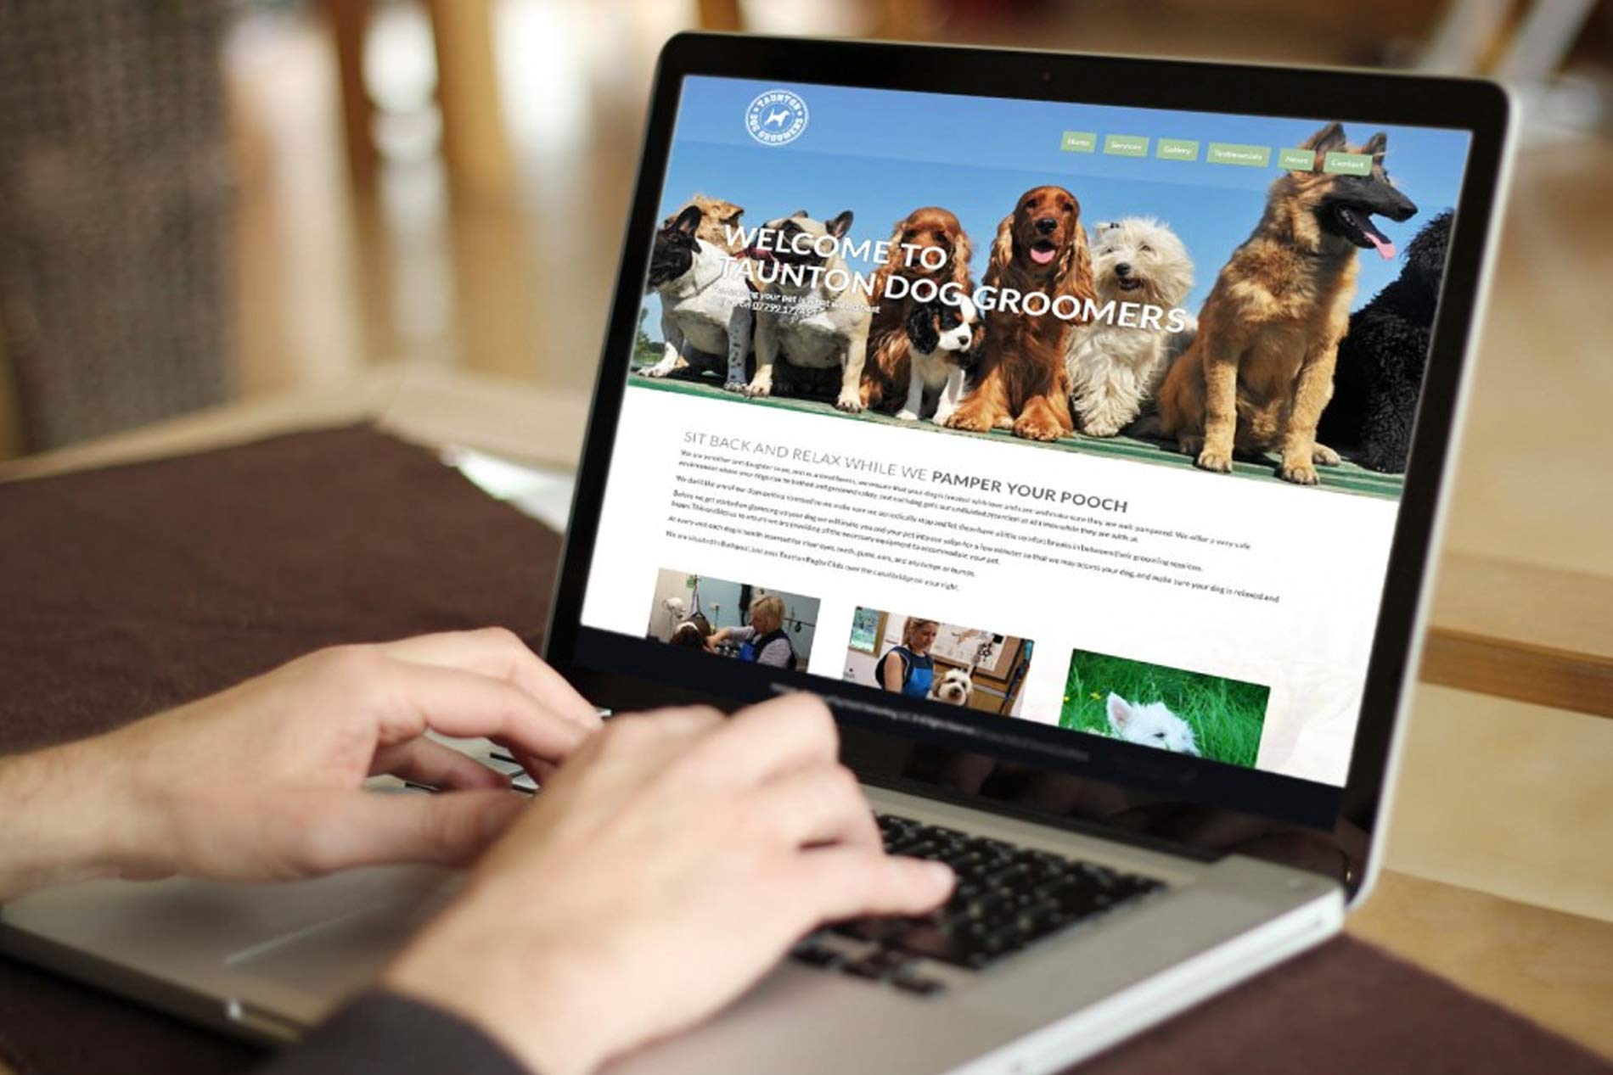
When a person uses a website as a source of information, what publishing information should he or she write down? Write at least 3 ideas in your notebook. Check your answers on the next slide.
Notes:
Photo source 5: Noronha, Tanya. “How to Host a Domain/ Website on Your Own?” Reseller Club, 21st December, 2017, https://blog.resellerclub.com/how-to-host-a-domain-website-on-your-own/. Retrieved 11th March, 2021.

Slide 11
author's name article's name
website's name web address
date of publication
date that you visited the website

Slide 12
Example 2:
Author's name: Courtney Gahan
Name of the article: “MLA Journal Citation”
Name of the website: Scribbr
Web address: https://www.scribbr.com/mla/journal-citation/
Publication date: 16th April, 2019
Date that you visited the website: 5th March, 2020

Slide 13
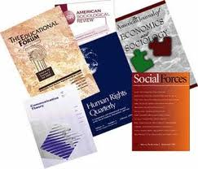
When a person uses an academic journal (a magazine that is only about academic essays) as a source of information, what publishing information should he or she write down? Write at least 3 ideas in your notebook. Check your answers on the next slide.
Notes:
Photo source 6: Druett, Joan. “Pros and Cons of Academic Journals”. World of the Written Word, 24th April, 2012, http://joan-druett.blogspot.com/2012/04/pros-and-cons-of-academic-journals.html. Retrieved 11th March, 2021.

Slide 14
author's name article's name
page numbers for the article (first page and last page)
journal's name volume number
edition number publication date
database name
database/ article website

Slide 15
Example 3:
Author's name: Molly Geidel
Article's name: “Building the Counterinsurgent Girl”
Page numbers: 635 - 665
Journal's name: Feminist Studies
Volume number: 44 Edition number: 3
Publication date: 2017
Database name: JSTOR
Database/ article website: www.jstor.org/​stable/10.15767/​feministstudies.44.3.0635.
Notes:
Source: Adapted from Gahan, Courtney. “MLA Journal Citation”. Scribbr, 16th April, 2019, https://www.scribbr.com/mla/journal-citation/. Accessed 5th March, 2020.

Slide 16
When a person uses a newspaper or magazine as a source of information, what publishing information should he or she write down? Write at least 3 ideas in your notebook. Check your answers on the next slide.
*If the person accesses the newspaper or book online, he or she should treat it like a website.

Slide 17
author's name publication date
article's name
magazine or newspaper's name
page number (where the information from the article is)

Slide 18
Example 4:
Author's name: Mary Anderson
Publication date: March 2020
Article's name: “The Trail Blazer”
Magazine’s name: Shape
Page number: 56

Slide 19
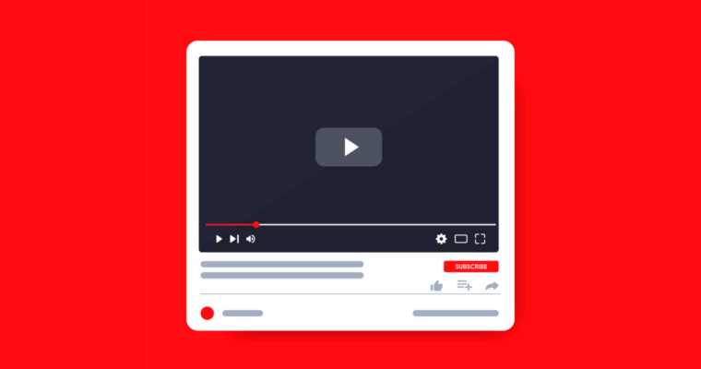
When a person uses a video online as a source of information, what publishing information should he or she write down? Write at least 3 ideas in your notebook. Check your answers on the next slide.
Notes:
Photo source 7: Jarboe, Gregg.”How YouTube Make Video Builder a More Useful Tool”. SEJ, 17th June, 2020, https://www.searchenginejournal.com/make-youtube-video-builder-tool-more-useful/372014/#close. Retrieved 11th March, 2021.

Slide 20
creator's name video's name
website's name
name and role of anyone who contributed (director, producer, commentator, actor)
the version publisher's name publication date
website address
(The researcher may not be able to find all of these pieces of information for every video he or she uses.)

Slide 21
Example 5:
Creator's name: Yalda Mostajeran
Video's name: “What E. Coli Does to Your Body”
Website's name: Buzzfeed
Name and role of anyone who contributed: Images by Getty
Publisher’s name: Buzzfeed News
Publication date: 10th June, 2018
Website address: https://www.buzzfeed.com/bfmp/videos/59447

Slide 22
Using other types of sources of information is unusual. If a person doing research did use another type of source, which three piece of information should he or she find out about the source? Write your answers in your notebook. Check your answers on the next slide.

Slide 23
source's name
the name of the author, speaker, or creator (if it's something that isn't written or spoken)
publication date

