Slide 1
Reading and Questions for Surveys

Slide 2
What product is being advertised?

Slide 3
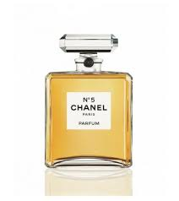
Chanel No. 5
perfume: the scent of something sweet-smelling

Slide 4
Page 64 Part B
When was Chanel No 5 created?
Who is Marianne Etchebarne?
How much did the film cost?
What kind of film is it?
Why are brands looking at new ways of connecting with consumers?
What does Ms. Etchebarne think of the film?
F. In 1912
C. She is Chanel’s artistic director
E. Eighty (80) million pounds
B. It is a thriller
A. Because advertising budgets are getting larger
D. She thinks it is a pure commercial

Slide 5
Page 64 Part C
When was Chanel No 5 created?
Who is Marianne Etchebarne?
How much did the film cost?
What kind of film is it?
Why are brands looking at new ways of connecting with consumers?
What does Ms. Etchebarne think of the film?
F. In 1921 (line 5)
C. She is Chanel’s marketing director (line 52)
E. Eighty (18) million pounds (line 62)
B. It is a fairytale romance (line 25)
A. Because customers are resistant to traditional advertising (lines 69-74)
D. She thinks it is a real piece of art (L55)

Slide 6
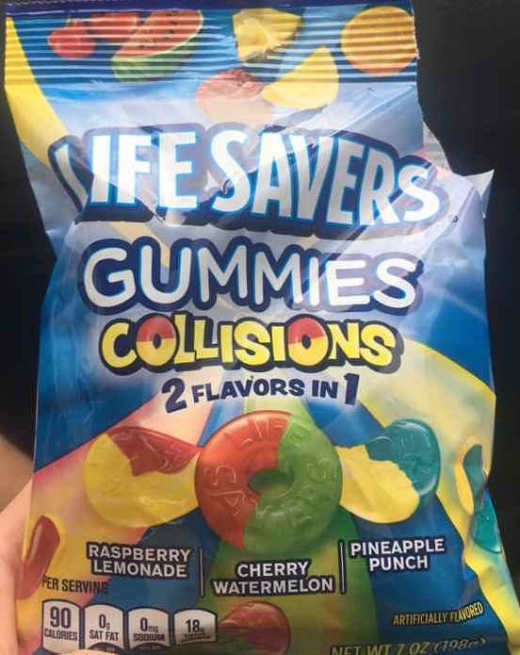
Buy vs Spend vs Cost vs Purchase
buy: to get something by paying money (purchase: to buy something)
cost: requires the payment of
spend: to give money as a payment
The bag of candy spends/costs/buys $5.
Tom wants to spend/buy/cost a bag of candy.
He purchased/spent/bought/costed $5 on
a bag of candy.

Slide 7
Scan Reading Activity: Page 52 Exercise D
If your name is closer to the letter A, you are student A.
Turn to page 137
If your name is closer to the letter Z, you are student B.
Turn to page 143.
Fill in the blank spaces
Ask your partner your questions (use article on page 52 to answer your partner’s questions
SCAN READING for SPECIFIC INFORMATION

Slide 8
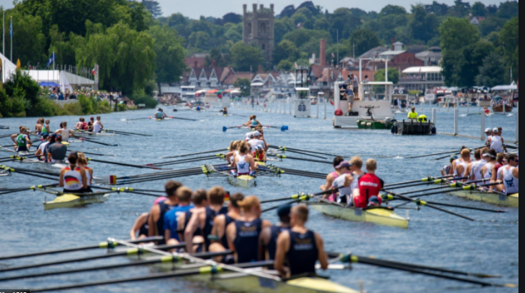
Student A (page 137): Question #2
Q: How much ___________ to entertain someone at the Henley Regatta?
does it cost
A: $600 a day

Slide 9
Student A: Question 1
Q: Why __________ always have to come up with new and exciting _____?
do companies ideas
A: Because every year some of the clients they have to entertain are the same.
Student B: Question 3
Q: __________ companies _________ huge amounts of money on entertainment?
Why do spend
A: Because keeping a customer is more cost-effective than looking for a new one.

Slide 10
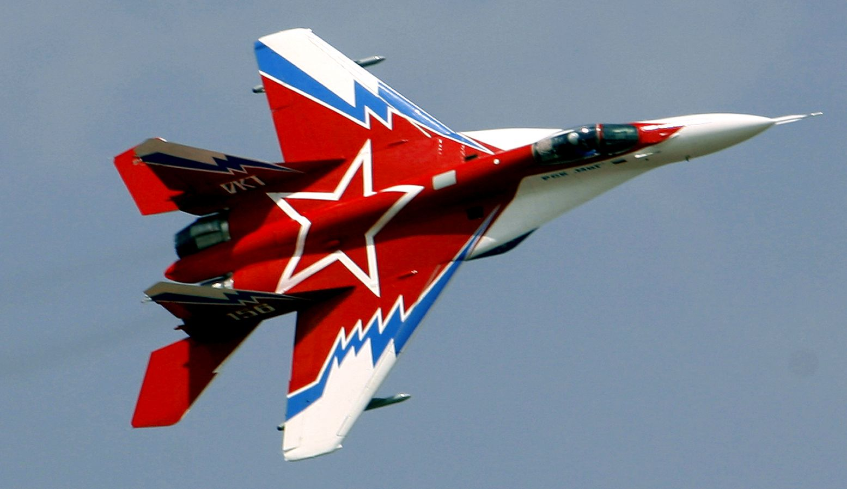
Student A (page 137): Question #3
Q: ______________ a ride in a MIG-29 jet fighter __________?
How much does cost
A: $18,000 a day

Slide 11
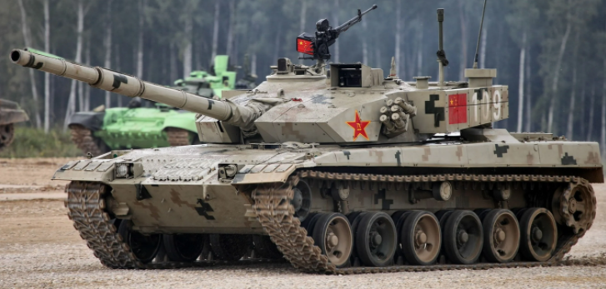
Student B (page 143): Question #1
Q: How much _____________ to spend a day __________?
does it cost in a tank
A: $18,000 a day

Slide 12
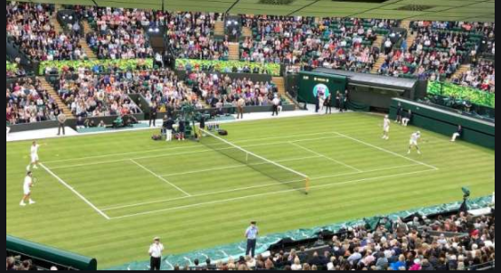
Student B (page 143): Question #2
Q: _____________ a corporate hospitality suite seat
How much does
at Wimbledon tennis tournament __________ ?
cost
A: It costs $2,000

Slide 13
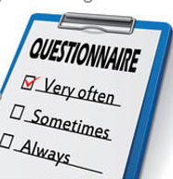
How Does a Company Learn About its Customers?
Companies use surveys to ask customers about themselves
Companies have focus groups to test products and advertisements
Who answers a consumer survey?
The customer answers the survey!
If you are writing a survey, should you answer the questions?
NO!

Slide 14
Vocabulary
Focus Group
a demographically diverse group of people assembled to participate in
a discussion about a particular product before it is launched.

Slide 15
Survey Questions
→ Demographics
Who is the customer? Age/sex/income level/job
→ Product Usage
Does your product address the customer’s needs?
→ Customer Satisfaction
Is the customer happy?
→ Product Evaluation
feedback on different aspects and features of a product
→ Customer Experience
what do customers think of your brand/advertising?

Slide 16
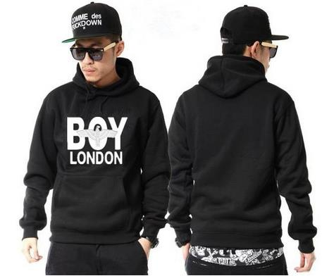
How to Write a Survey
__ 0-100元
__ 100-500元
__ over 500元
__ Yes
__No
__1 time
__ 2-3 times
__ 3+ times

Slide 17
How to Write a Survey
How important is it to you that BOY clothing is produced in the USA or UK?
Where have you seen BOY advertisements in the last 6 months?
__ very important
__ somewhat important
__ not important
__ on a poster
__ on TV
__ on the Internet
__ in a magazine __/newspaper

Slide 18
Classwork #4
In your speech groups, create a consumer survey about the company you will do for your speech
Send ONE DOCUMENT to Phill on WeChat with your questions and answer choices for customers.

Slide 19
Classwork #4
Quiz #5
Send one document of Classwork #4 to Phill on WeChat. (Survey)
Send before you go to bed
Complete page 27 Exercise B Listening (3.4 at https://qiba.space/market-leader-pre-int-unit-3/)
AFTER YOU COMPLETE THE ABOVE EXERCISE
Quiz #5 on Edmodo
Due Brisbane/Canberra/Sydney/Melbourne 17-NOV-2020 14:00

